Slide 1
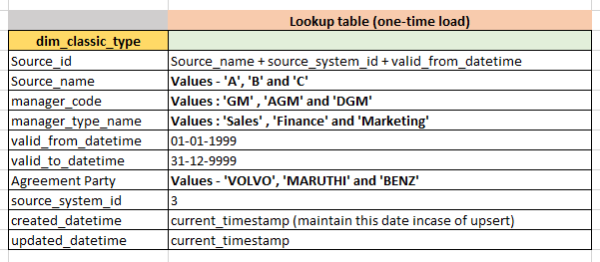
Azure ADB
How to Encrypt Columns using Data bricks SQL Editor

Slide 2
How to Encrypt Columns using Azure Databricks SQL Editor?

